Slide 1



New Age Interactive Soccer Training System
Arnold Lee
CS 523 – Interactive Design
Final Presentation
November 29th , 2011

Slide 2
Recap…..
A (closed to) real time instructional system for K-9
Promote team spirit and improve communication skills on and off the field
Proper play tactics
Curb selfish behavior

Slide 3
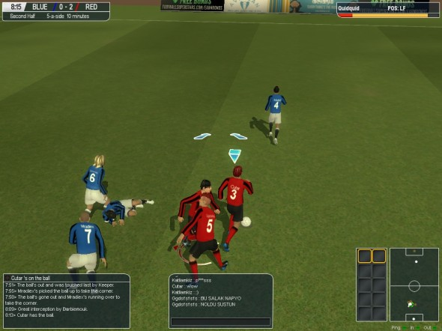
Not just in the real world….
Screenshot from MMO “Football Superstars”

Slide 4
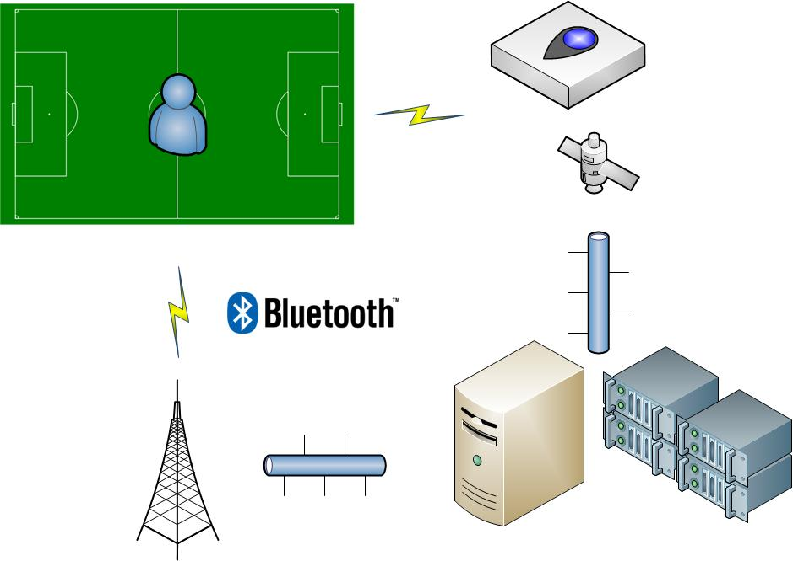
Schematics

Slide 5
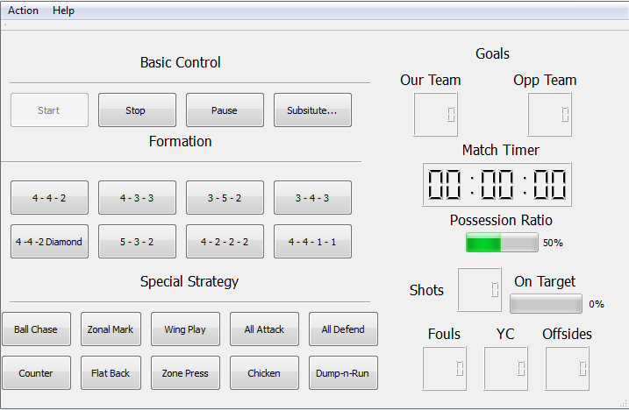
NAISTS GUI on terminal side

Slide 6
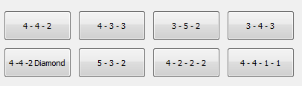
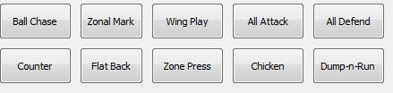
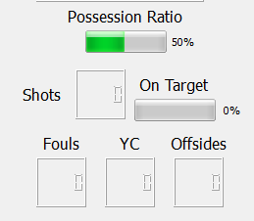
Design Revision
Added starting formation
Special Strategies
not all working at the moment
More in-match statistics

Slide 7
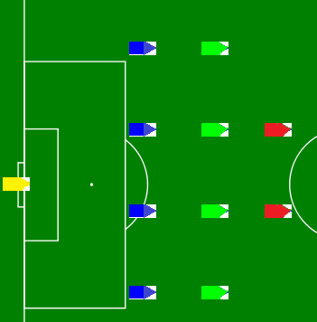
Players now have directional component

Slide 8
To bring this to real….
Input
GPS -> location coordinates
Imaging sensor -> direction
Output
Bluetooth -> your suggested next action

Slide 9
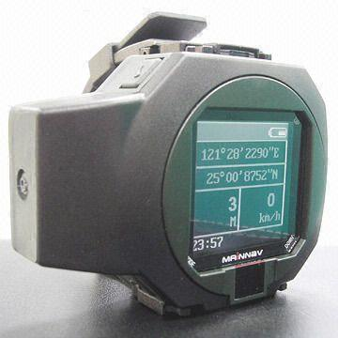

Global Positioning System
To acquire location information on field
Every player on the training side wear a watch
Need to customize software for proper input to NAISTS
Directional information not available
Min Resolution: 2 – 3 meters ( 6 – 9 ft.)
Carrier Phase Enhancement GPS: 3 cm (1.2 in)
Estimated cost per player: $220

Slide 10
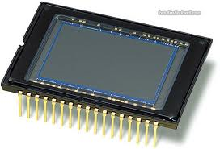
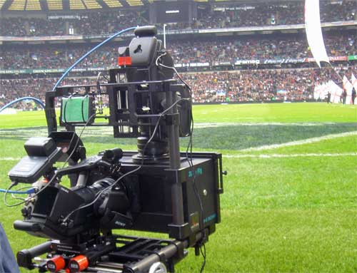
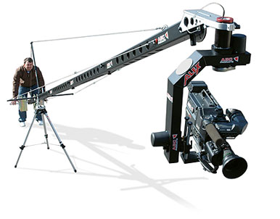

Imaging sensor
To obtain directional information otherwise unavailable via GPS
Requires a camera (CCD) – type device and modification
Each training player must wear a triangular light-sensitive device (i.e. tinfoil hat)
Estimated cost per player: $900
3 camera * $3000 each / 10 players

Slide 11
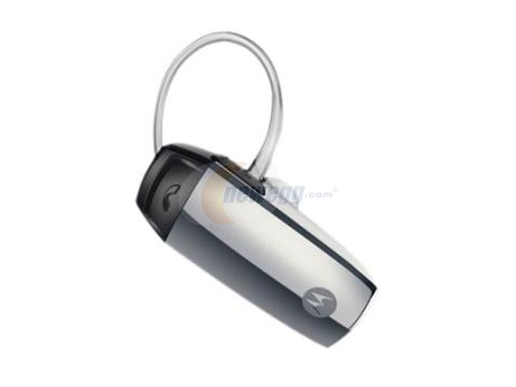
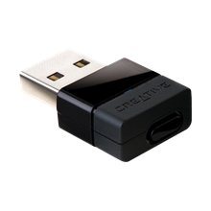
Bluetooth
Transmit speech information from NAISTS to the player
Each player must wear a headset that sticks
Transmission modules that cover the whole field
Each Class-1 transmitter can send up top 100 meters
Estimated cost per player: $81
$85 * 6 transmitter
$30 * 10 receiver

Slide 12

$$$$$$$$$$$$$$$$$$$$$$$
Total estimate cost per player: $1200
This includes monthly cost of using the GPS (~ $20 per player)
This does not include labor/time spent on modifying the software to comply with the input of the system
This does not include maintenance of the devices

Slide 13
Demo Time….

